Slide 1
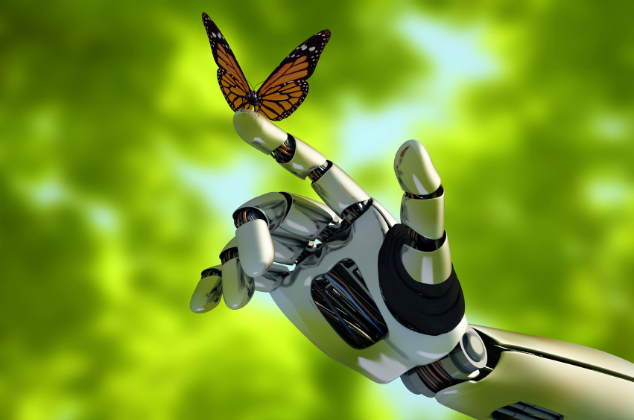

Slide 2
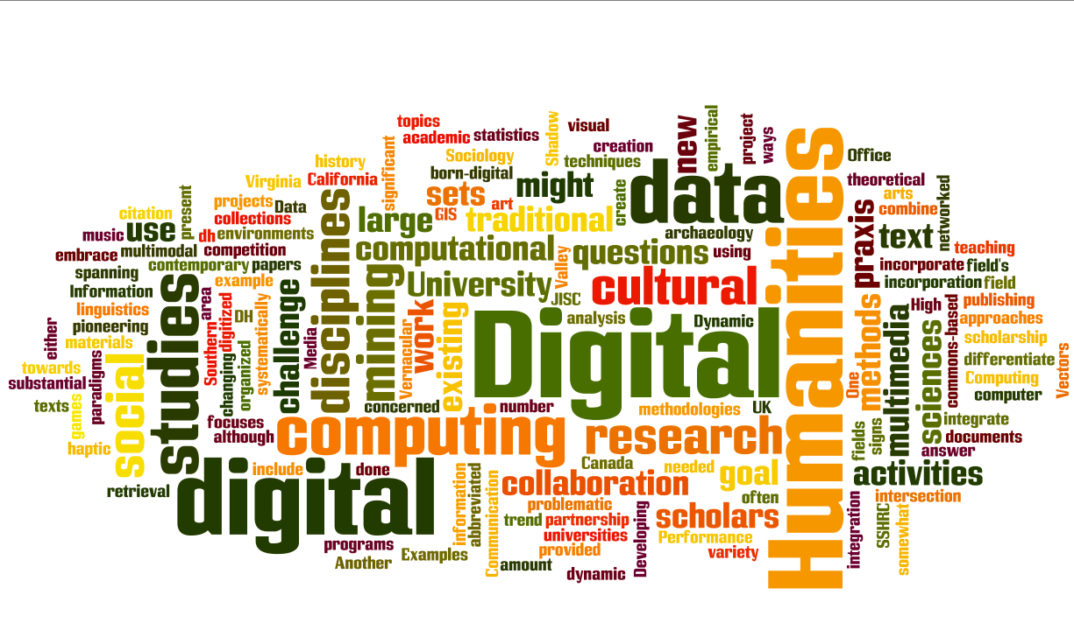

Slide 3
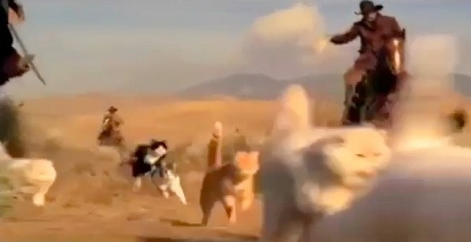
Herding Cats

Slide 4
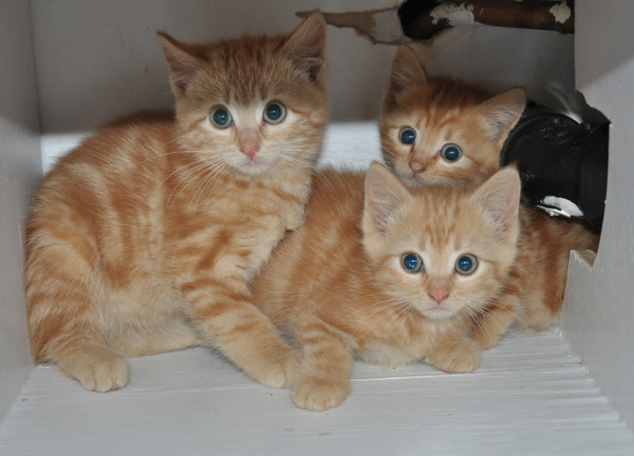
Digital Humanities for the Rest of US

Slide 5
Humanities
Digital

Slide 6
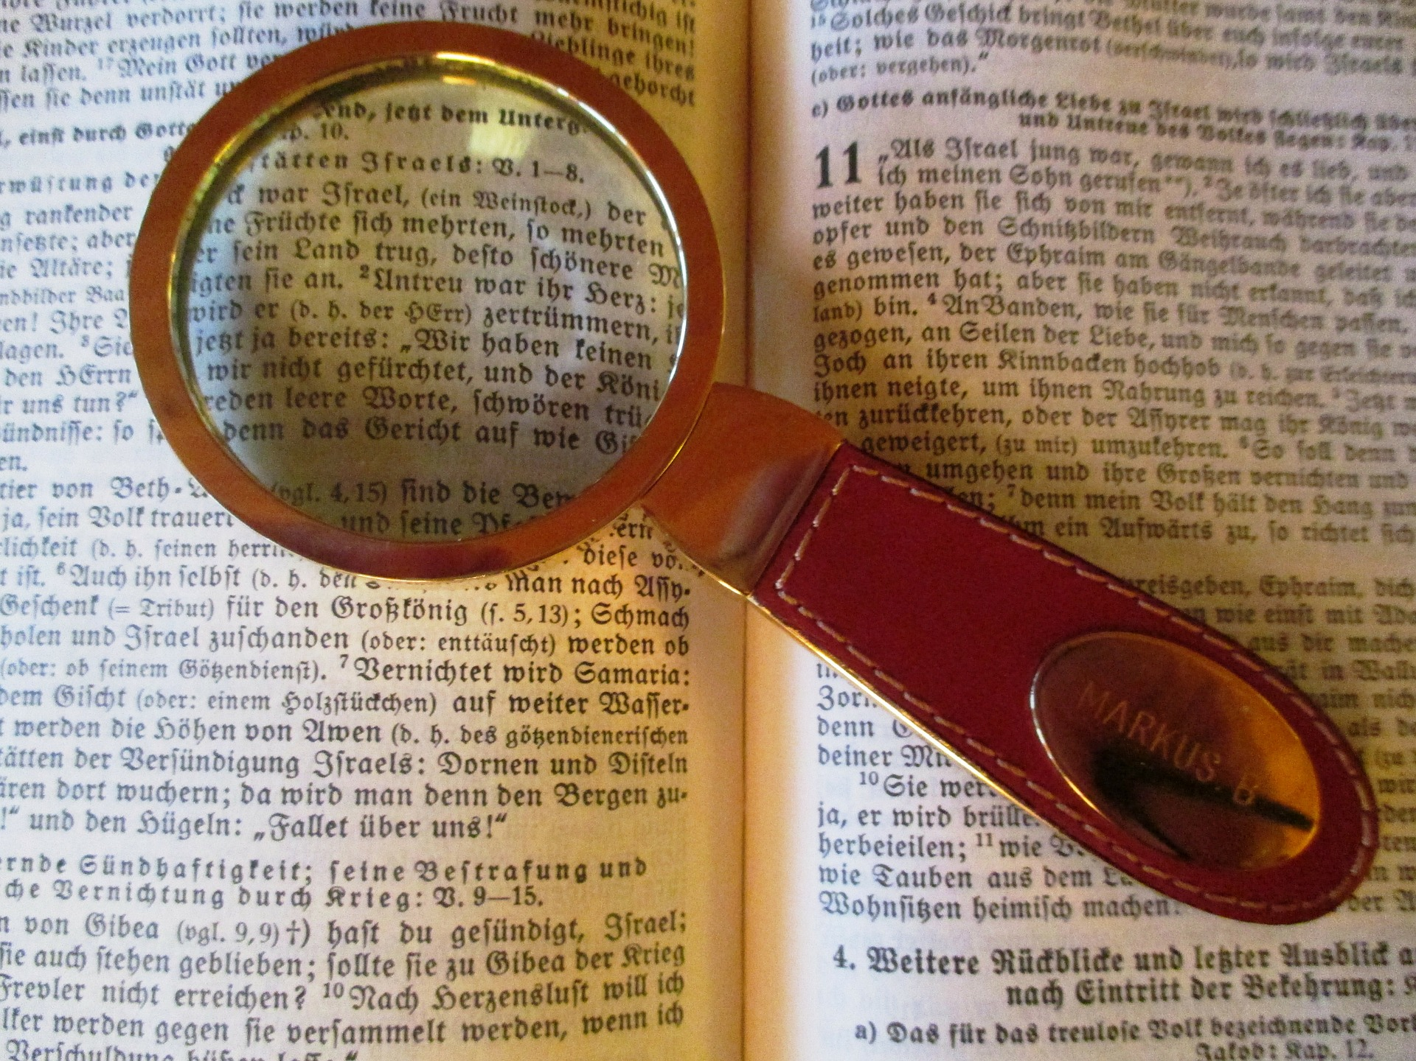
Discovery
Research

Slide 7
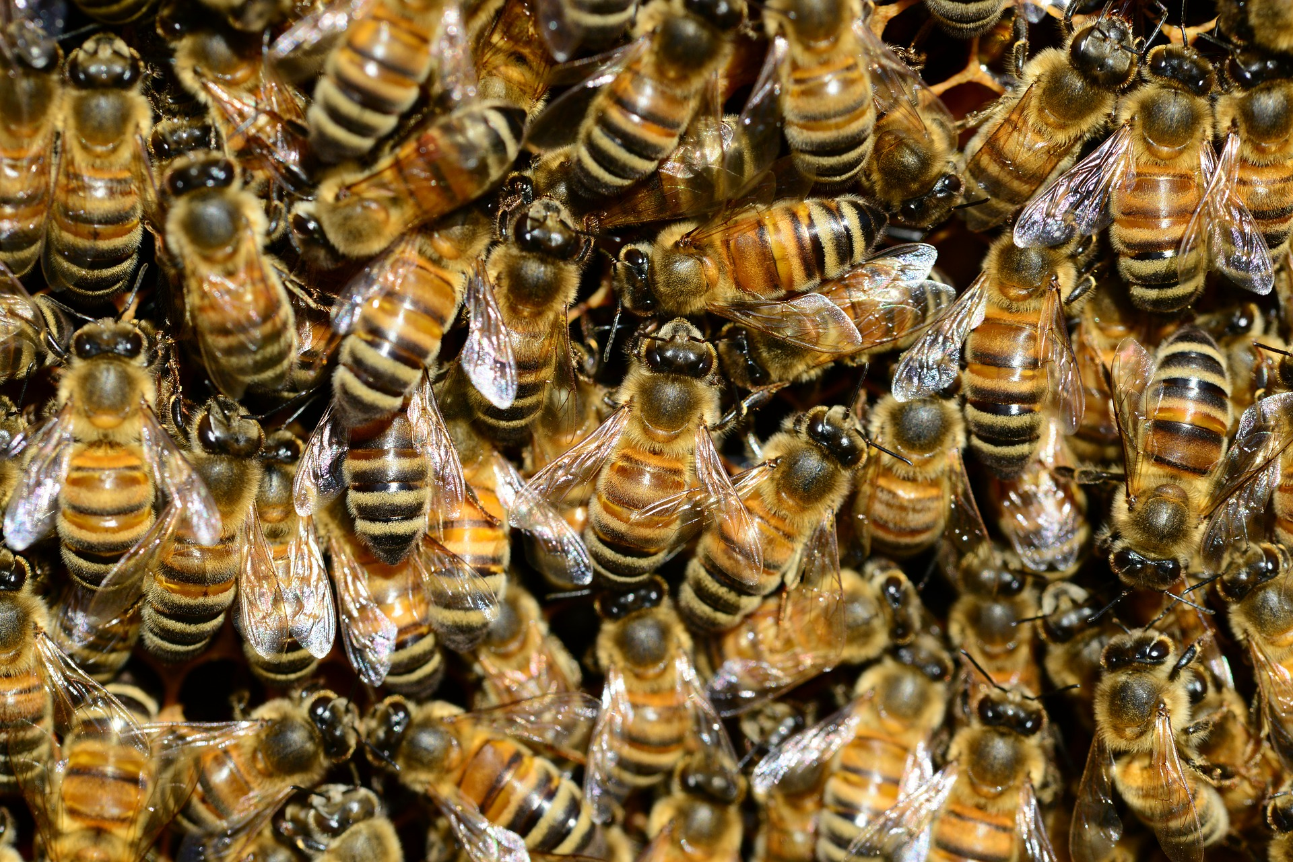
Aggregate
Create
Curate

Slide 8
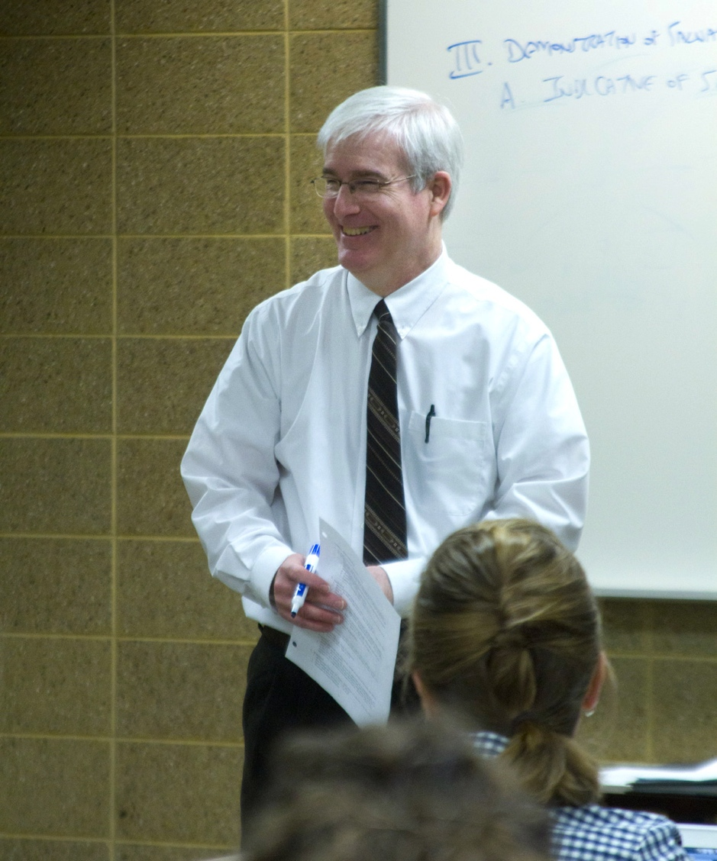
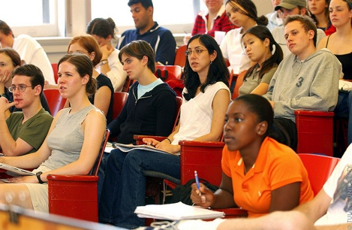
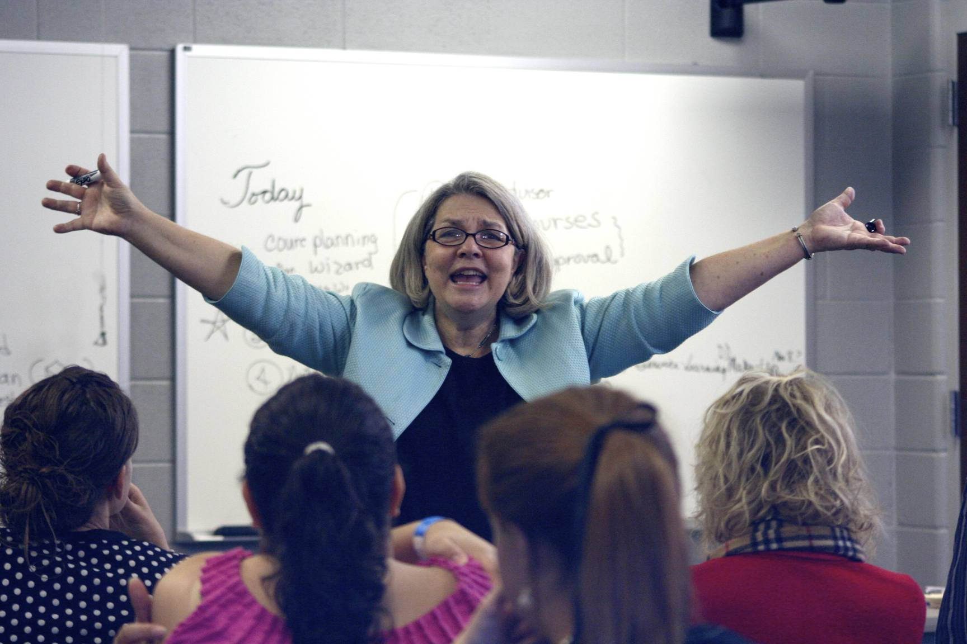
Students
Faculty
YOU! a.k.a Librarians

Slide 9
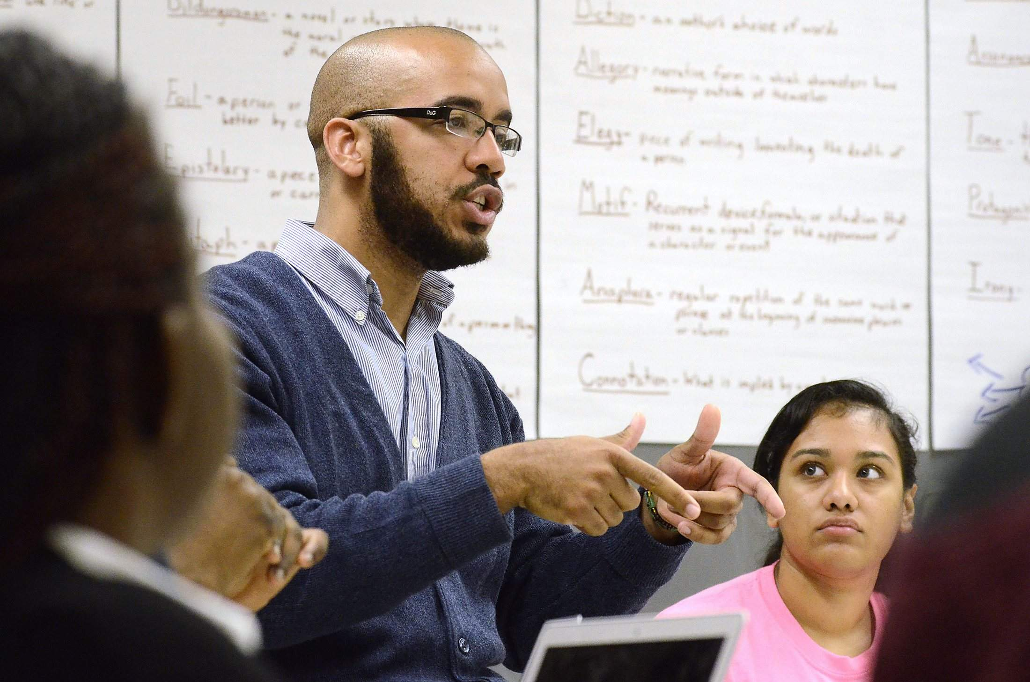
Teaching
Collaborating

Slide 10
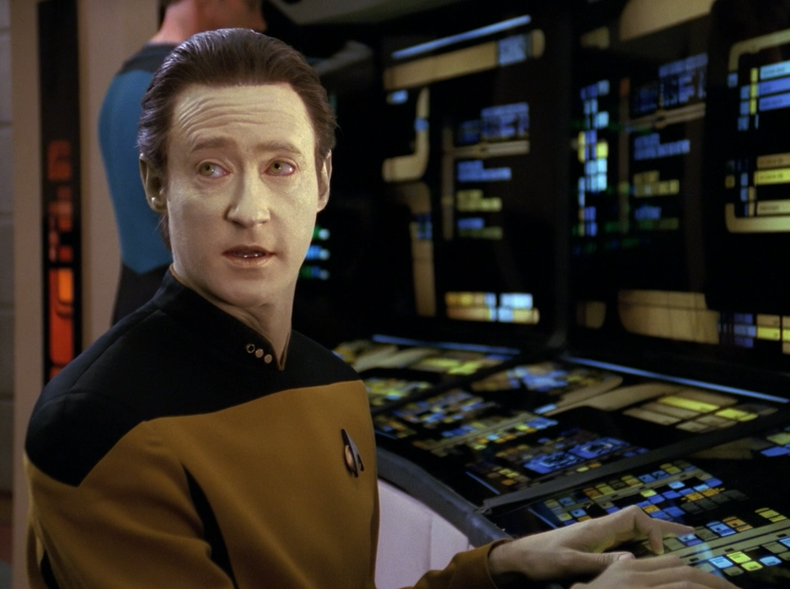
DATA

Slide 11
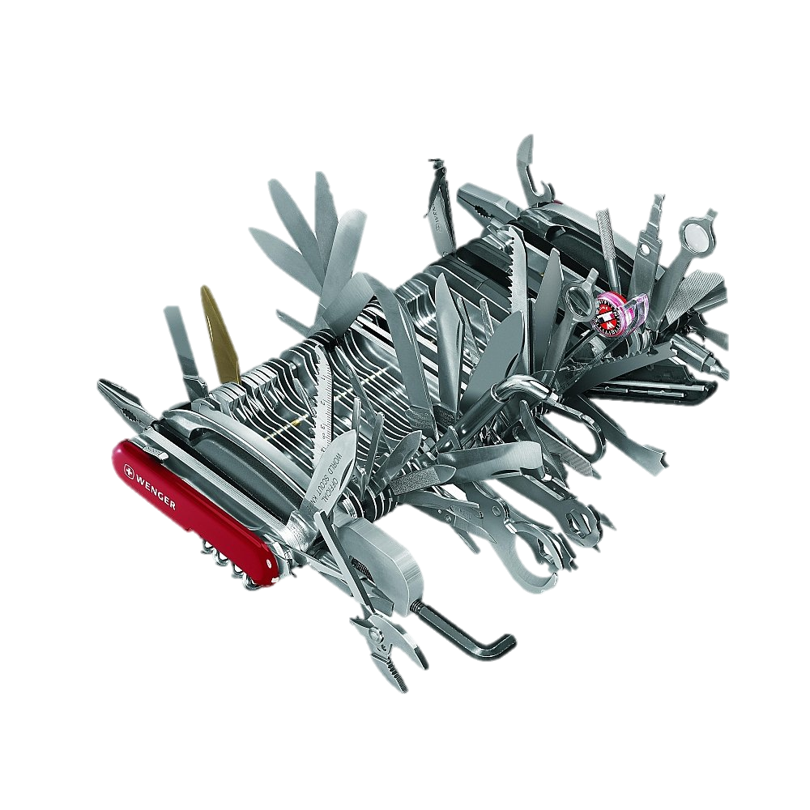
Technology
Tools
guides.library.uncc.edu/dh

Slide 12
Slide 1: http://robohub.org/wp-content/uploads/2013/10/
Slide 3: http://www.ponziclawbacks.com/files/2013/06/Herding-Cats.jpg
Slide 4: https://c1.staticflickr.com/9/8147/7570131560_c8202d18a6_z.jpg
Slide 5: http://pixabay.com/en/read-magnifying-glass-bible-study-259169/
Slide 6: http://pixabay.com/en/honey-bee-water-buckfast-insect-292132/
Slide 7 – Teaching: http://www.gazette.net/storyimage/PN/20131018/NEWS/131019085/AR/0/AR-131019085.jpg
Slide 7 – Collaborating: http://www.northwestern.edu/studentaffairs/assessment/media/images/hrpicture.jpeg
Slide 8 – Faculty: http://www.mbbc.edu/wp-content/uploads/
Slide 8 – Students: http://www.begincollege.com/wp-content/uploads/2012/07/College-Students-in-Class.jpg
Slide 8 – You: https://gigaom2.files.wordpress.com/2010/04/stock-teacher.jpg
Slide 9 – Star Trek Data: http://scifiempire.net/wordpress/wp-content/uploads/2013/04/Brent-Spiner-as-Data-Sins-of-the-Father-Star-Trek-The-Next-Generation.png
Slide 9 – Data: http://www.chilmarkresearch.com/2013/12/23/looking-ahead-data-visualization/
Slide 10: http://www.swissarmy365.co.uk/images/products/zoom/1276726395-45412600.jpg

