Slide 1

Personal Librarian: From Resources to Relationships
Jean Moats
Joe Eshleman
Valerie Freeman
Richard Moniz
Jo Henry
David Jewell

Slide 2

AGENDA
History of Personal Librarian
Personal Librarian Program at Johnson & Wales Charlotte Campus
Personal Librarians and Embedded Librarians
Personalizing and Branding for Liaisons
Personal Services Ideas -Outside and Inside the Library and the Campus
Personal Librarian – Faculty Perspective
Best Practices
The Future

Slide 3
History
First mentioned in 1984 -
Newton Gresham Library (NGL) at Sam Houston State University
1996 - as an outreach initiative, the reference librarians at Cushing/Whitney Medical Library at Yale University School of Medicine started a Personal Librarian program
“The goals were simple: (1) divide the incoming medical student class evenly among five reference librarians; (2) send three to four messages in one year (so as not to inundate them with too much information); and (3) report anecdotally at the end of the first year.”

Slide 4
History CONTINUED
2000 University Of Richmond and Personal Outreach to Students
2008 Yale University Undergraduates
2010 Drexel University
Other programs from large schools to smaller schools.

Slide 5
Implementation at Johnson & Wales University - Charlotte
2011/2012 – Campus-wide retention committee with broad representation conducts brainstorming exercises
September 2012 – Personal Librarian pilot is implemented in all English Composition classes
September 2013 – Personal Librarian adaptation incorporated into Jumpstart, etc.
2013/2014 – Continued revision of Personal Librarian based on faculty and student feedback

Slide 6

Connecting to Past (and Future) Success
ACRL’s Information Literacy Competency Standards for Higher Education
ACRL’s new Framework

Slide 7

Connecting to Past (and Future) Success
Embedded Librarianship!

Slide 8




THE GOALS

Slide 9

PERSONALIZE!

Slide 10
Andrea Pampaloni & Nora Bird (2014)-Community College Study
“Building Relationships through a Digital Branch Library: Finding the Community in Community College Library Web Sites”
Lorri Mon and Lydia Eato Harris (2011)-Professional Visibility
“The Death of the Anonymous Librarian”
Casey Kadavy and Kim Chuppa-Cornell (2011) Narrated Videos
“A Personal Touch: Embedding Library Faculty into Online English 102”
Susan E. Montgomery (2010)-Webster University Webinars
“Online Webinars! Interactive Learning Where Our Users Are: The Future of Embedded Librarianship”
Brett Nunn and Elizabeth Ruane (2012)-Mississippi State F2F
“Marketing Gets Personal: Promoting Reference Staff to Reach Users”

Slide 11



Slide 12
THINKING OUTSIDE THE BOX – OUTSIDE HIGHER EDUCATION
Bookstores
British Airways Networking in the Sky Event (2008)
White Spas (2013)
Ebsco

Slide 13
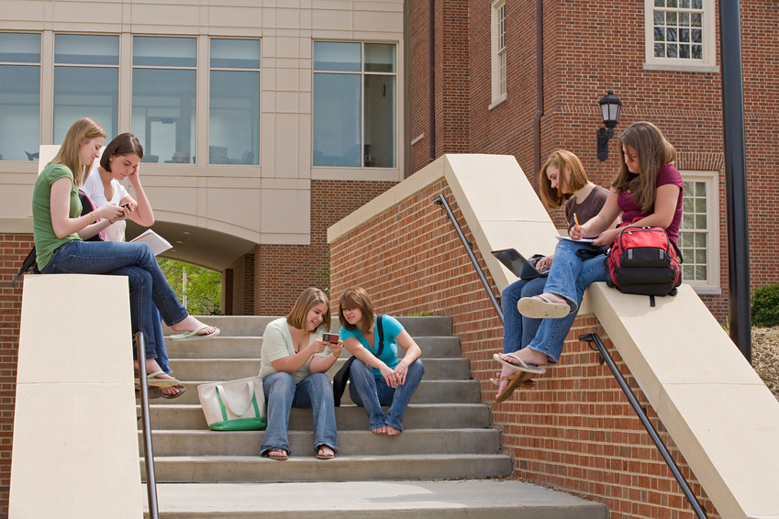
THINKING OUTSIDE THE BOX – INSIDE HIGHER EDUCATION
Academic Support Centers
Information Technology Services
Career Services
Health Services
Student Affairs

Slide 14
THE FACULTY PERSPECTIVE
 | Winter Term | Spring Term
Strongly Agree | 16.67% (1) | 50% (2)
Agree | 83.33% (5) | 25% (1)
Neither Agree or Disagree | 0% | 25% (1)
Disagree | 0% | 0%
Strongly Disagree | 0% | 0%
“I incorporated the Personal Librarian Program in a meaningful way into my English course.”

Slide 15
THE FACULTY PERSPECTIVE
 | Winter Term | Spring Term
Strongly Agree | 0% | 25% (1)
Agree | 66.67% (4) | 50% (2)
Neither Agree or Disagree | 16.67% (1) | 0%
Disagree | 16.67% (1) | 25% (1)
Strongly Disagree | 0% | 0%
“The Personal Librarian Program helped my students on outcomes and/or objectives for the course, such as better research papers.”

Slide 16
THE FACULTY PERSPECTIVE
 | Winter Term | Spring Term
Very Favorable | 16.67% (1) | 75% (3)
Favorable | 50% (3) | 0%
Neutral | 16.67% (1) | 25% (1)
Unfavorable | 16.67% (1) | 0%
Very Unfavorable | 0% | 0%
What is your general opinion of the Personal Librarian Program?

Slide 17
THE FACULTY PERSPECTIVE
“I think that I could do more next term by encouraging my students to seek out their help more than they did this term. I think the students don’t see a need for the personal librarian until the final week of classes when essays are due. What I plan to do next term is incorporate the librarians in more of a direct way: actually have the students go to them for help and feedback for at least one assignment (probably finding and citing sources)”.

Slide 18

BEST PRACTICES
Web pages or videos that humanize the librarians
Assigning Personal Librarians to a specific department
Utilizing email to connect and encourage students
Marketing all the time
Learn from outside the library

Slide 19

THE FUTURE OF PERSONAL LIBRARIAN

Slide 20

QUESTIONS/THOUGHTS???

Slide 21

PUBLICATIONS
Coming Soon from ALA-Neal Schuman–
The Personal Librarian : Enhancing the Student Experience
Chapters
Where did PL develop/come from?
Personal Librarian: Development and Implementation of the Idea
Information Literacy
Embedded Librarianship
Librarian Liaisons
Personal Librarian: What can Other Sources Tell Us
Personal Librarian: Practical Possibilities
Personal Librarian: A Faculty Member’s Perspectives
Personal Librarian: Applying the Concept to Other Student Support Services
The Future of Personal Librarian
Available Now
Fundamentals for the Academic Liaison

Slide 22
References
Harris, Colleen, “The Case for Partnering Doctoral Students with Librarians: A Synthesis of the Literatures”, Library Review 60, no. 7 (2011): 604.
Wong, Shun Han Rebekah and Dianne Cmor, “Measuring Association between Library Instruction and Graduation GPA”, College & Research Libraries 72, no. 5 (September 2011): 470.
Cook, Jean, “A Library Credit Course and Student Success Rates: a longitudinal study”, College and Research Libraries, (May 2014).
Daum, Kevin. “Make it Memorable: Face-Face Connections Provide the Most Value.” Small Business Los Angeles 6, no. 3 (2010): 8.
Pampaloni, Andrea and Nora Bird, “Building Relationships through a Digital Branch Library: Finding the Community in Community College Library Web Sites”, Community College Journal of Research and Practice, (2014).
Mon, Lorri and Lydia Eato Harris, “The Death of the Anonymous Librarian”, The Reference Librarian, 52, no. 4 (2011), 352-364.
Kadavy, Casey and Kim Chuppa-Cornell, “A Personal Touch: Embedding Library Faculty into Online English 102”, Teaching English in the Two Year College TETCY, 39, no. 1 (2011), 63-77.
Montgomery, Susan E., “Online Webinars! Interactive Learning Where Our Users Are: The Future of Embedded Librarianship”, Public Services Quarterly, 6, no. 2-3 (2010), 306-311.
Nunn, Brett and Elizabeth Ruane, “Marketing Gets Personal: “Promoting Reference Staff to Reach Users”, Journal of Library Administration, 52, no. 6-7 (2012), 571-580.
Wang, Rui, “The Lasting Impact of a Library Credit Course”, portal: Libraries and the Academy, 6, no. 1 (2006), 79-92.
White, Alayne. “Marketing a Spa: How Alayne White Gets Them in the Door.” The Swipely Payment Marketing Blog, Last updated July 9, 2013, http://blog.swipely.com/marketing/marketing-a-spa-how-alayne-white-gets-them-in-the-door

