Slide 1
“Information Creation as a Process: Putting Together the Pieces
through Disparate Resources”
Metrolina Library Association
Charlotte, NC – June 9, 2016
Dr. Pam Dennis
Gardner-Webb University
Boiling Springs, NC

Slide 2
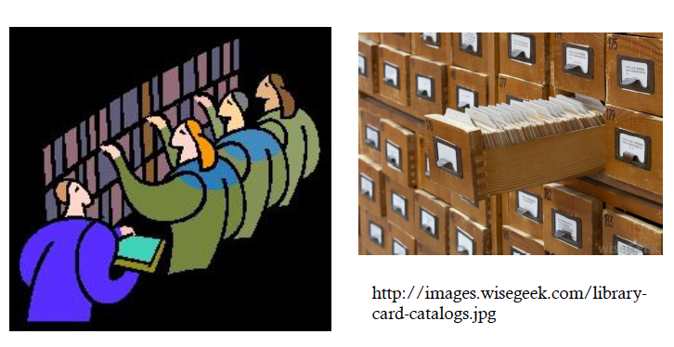

Slide 3
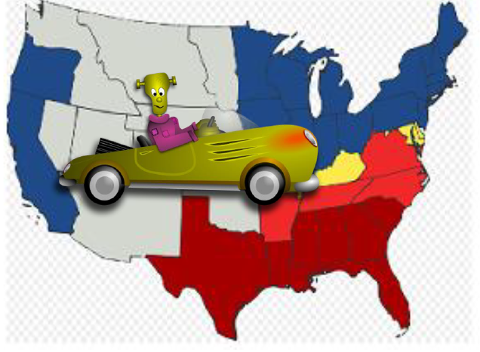

Slide 4
Digital Archives
Newspapers
Google Books
Google Scholar

Slide 5
Christopher Philip Winkler
Anton Shide
Charles Utermoehlen
Erwin Schneider
Rudolph Richter
German musicians who taught in Jackson, Tennessee

Slide 6
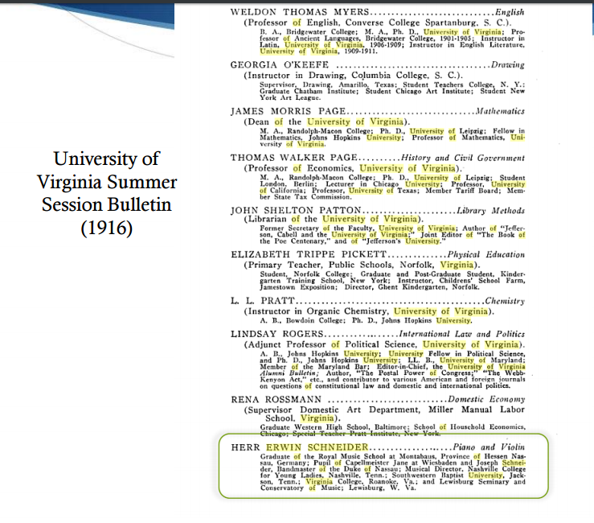

Slide 7
Erwin Schneider 1843-1922

Slide 8
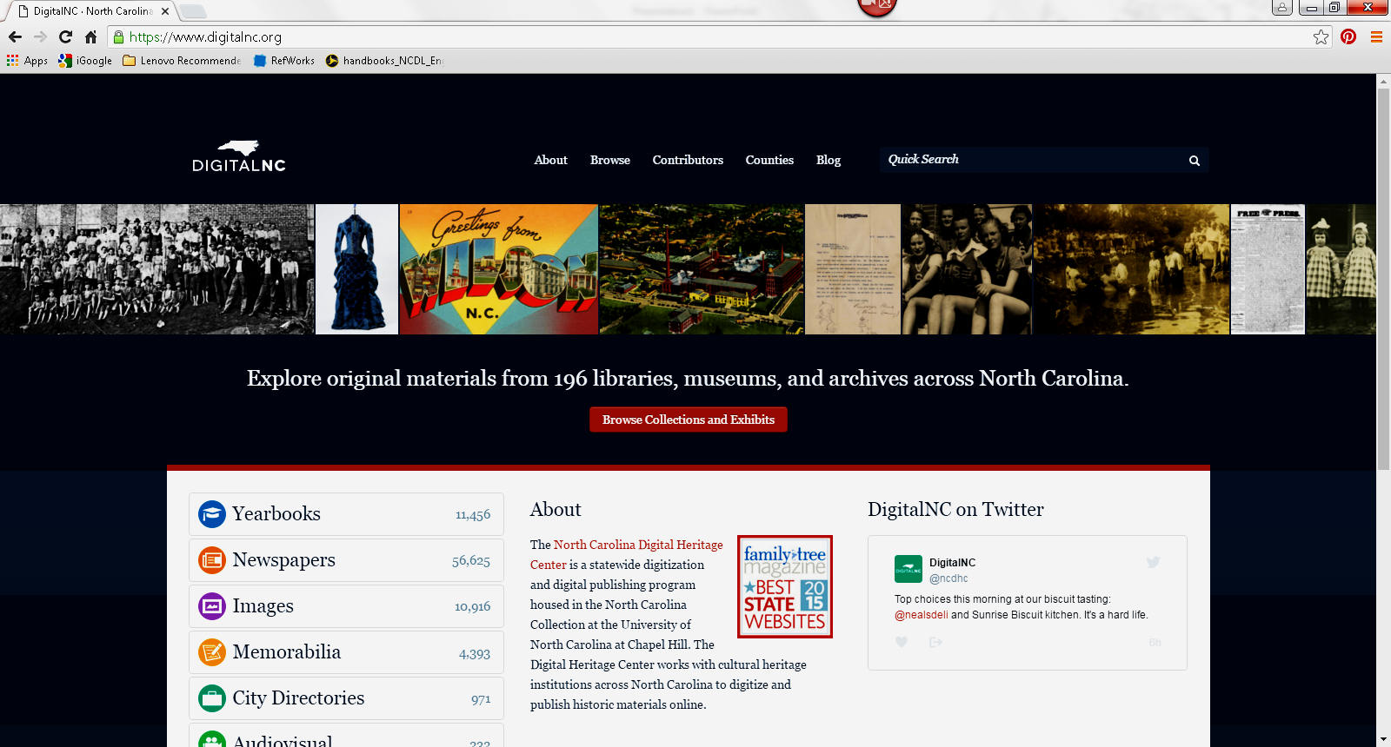
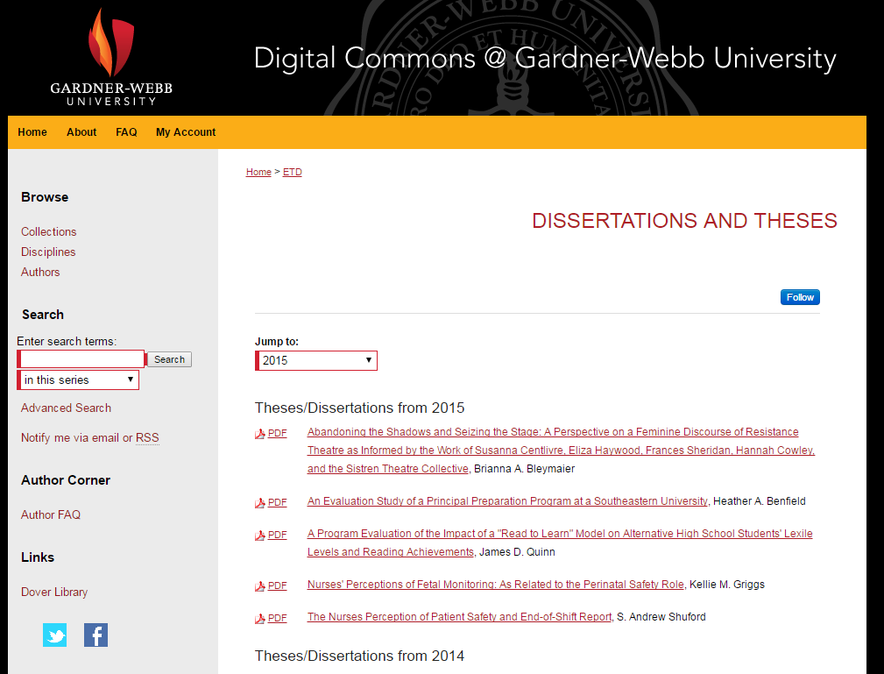

Slide 9
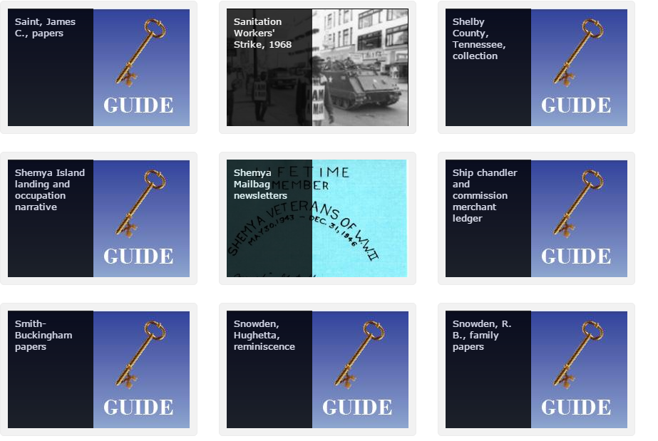
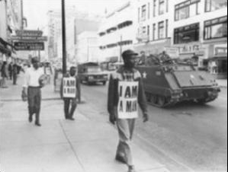
Digital Archives, University of Memphis

Slide 10
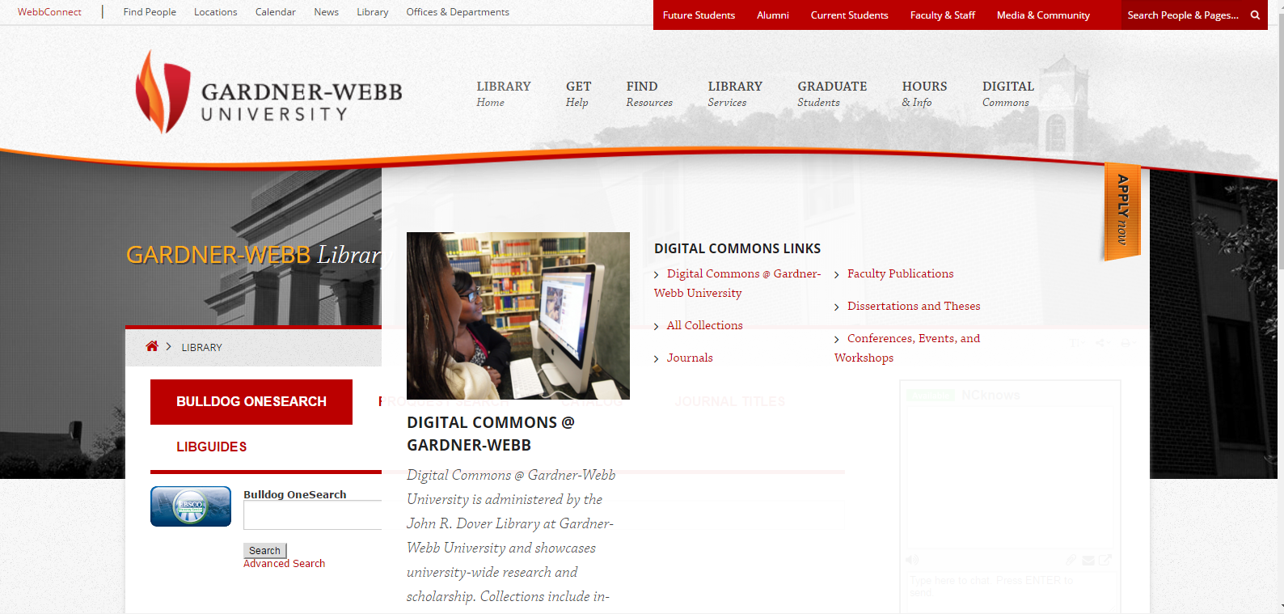

Slide 11
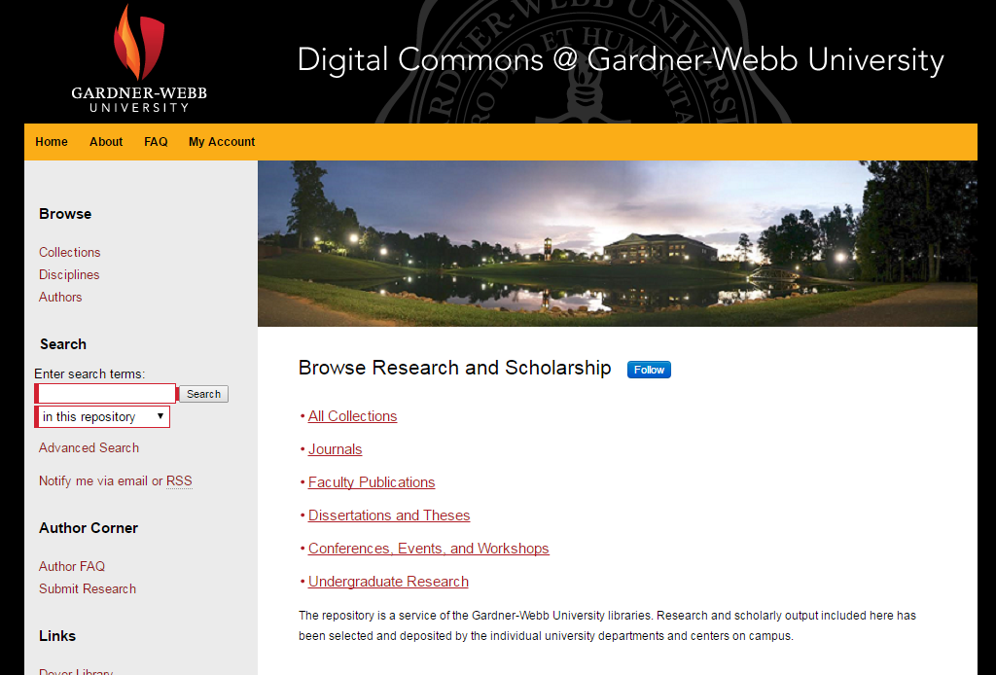

Slide 12
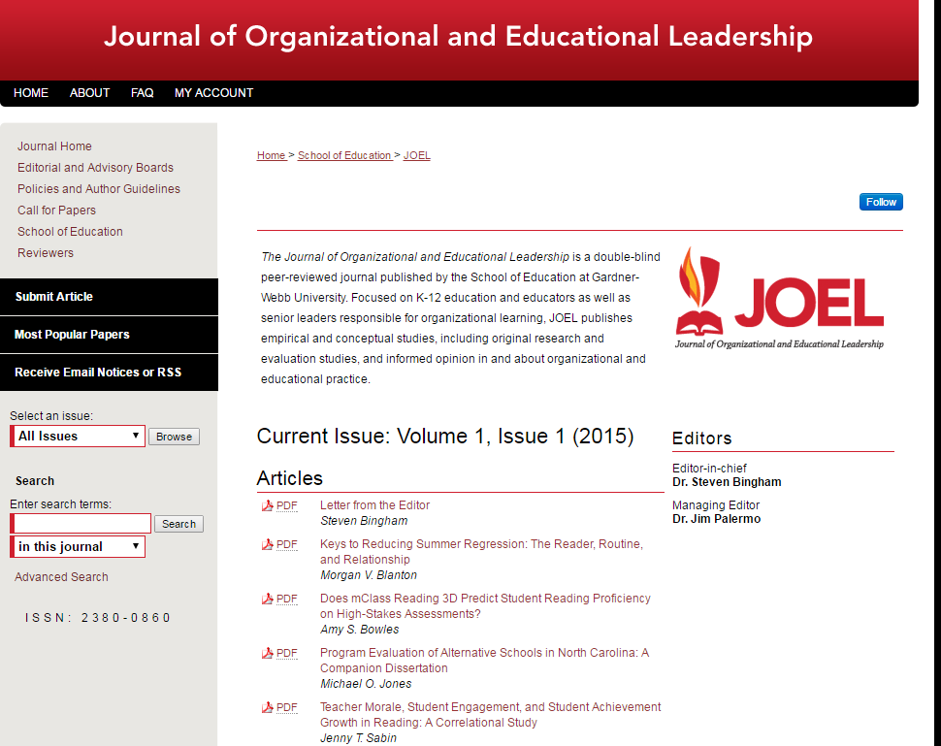
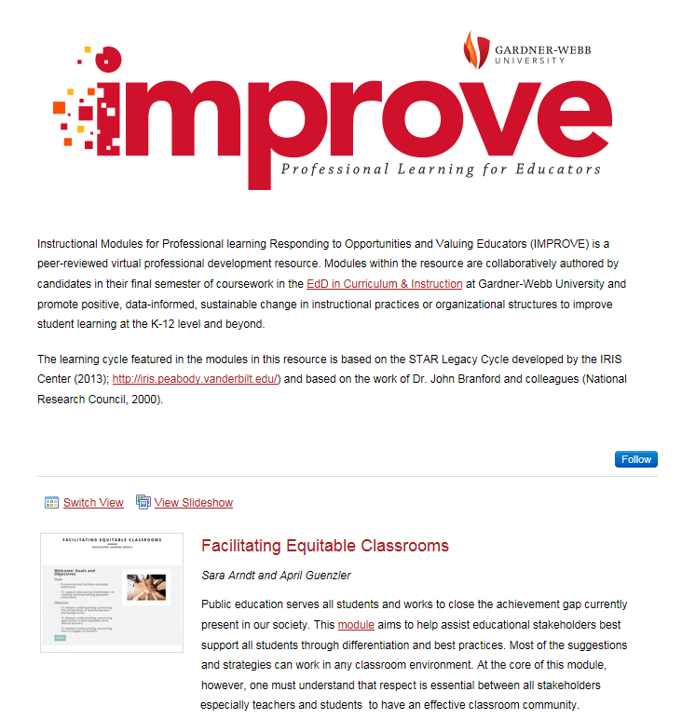
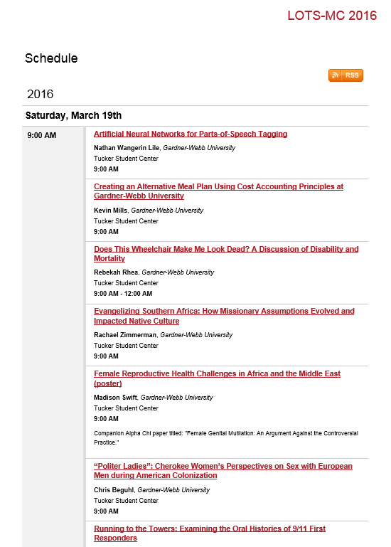
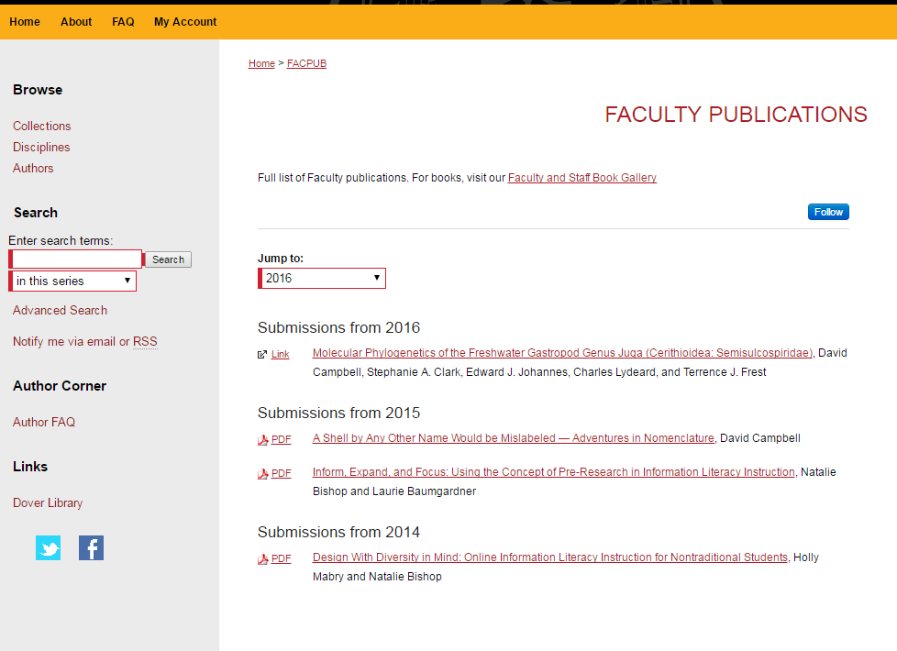

Slide 13
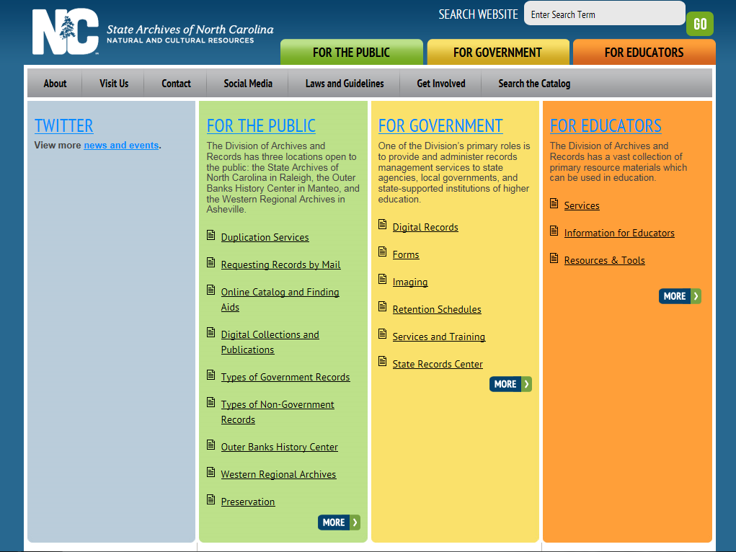
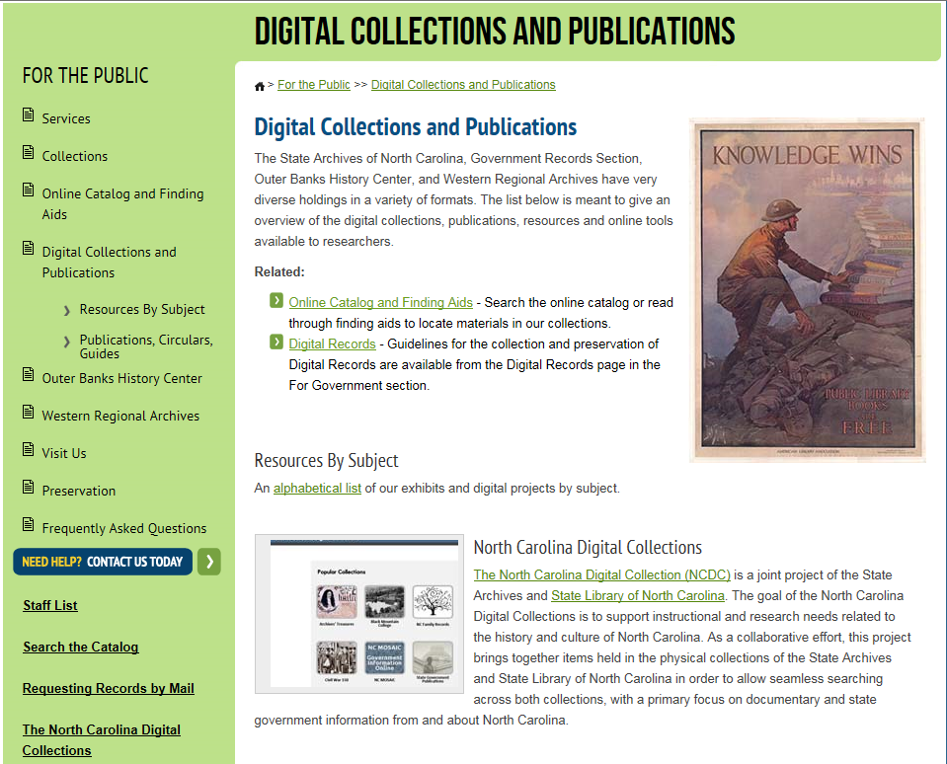

Slide 14
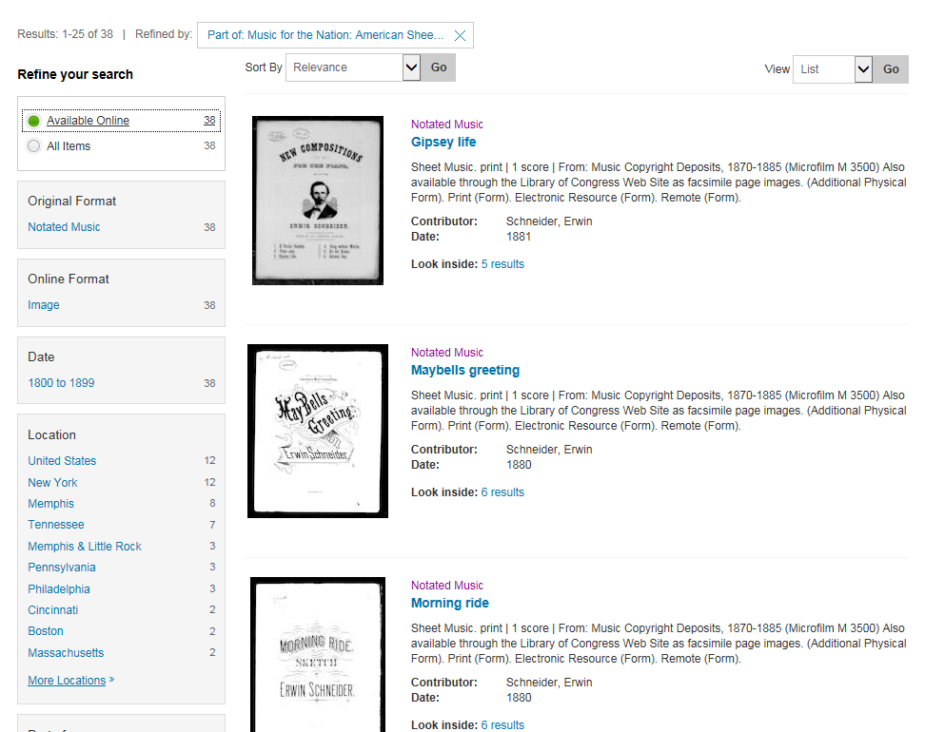
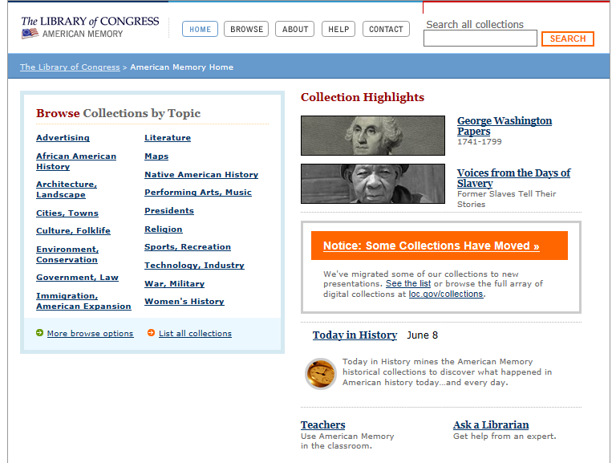

Slide 15
Newspapers

Slide 16
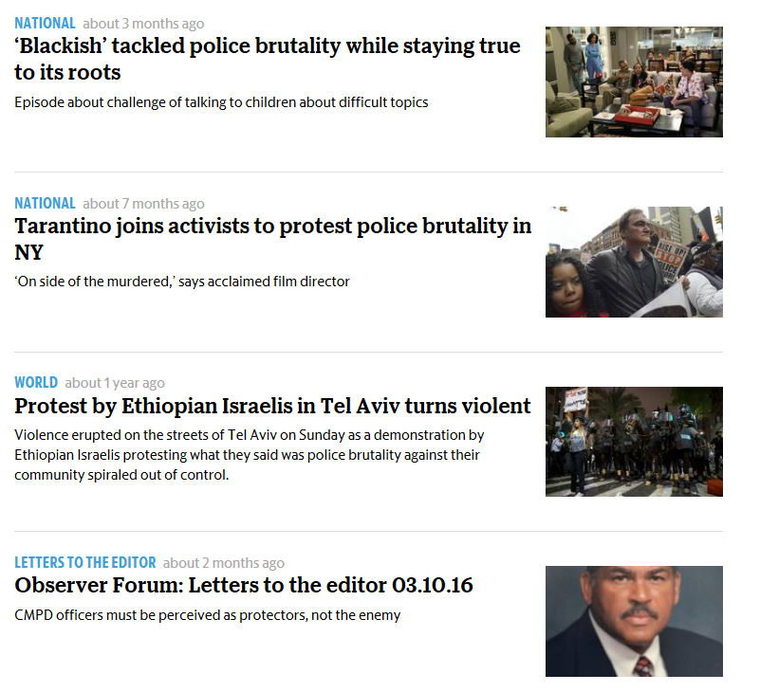
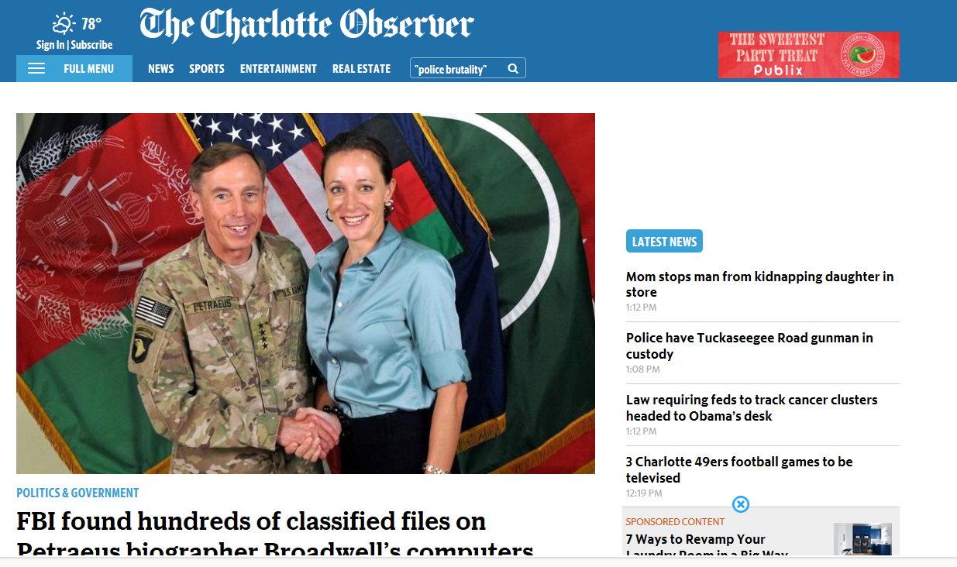
The Charlotte Observer

Slide 17
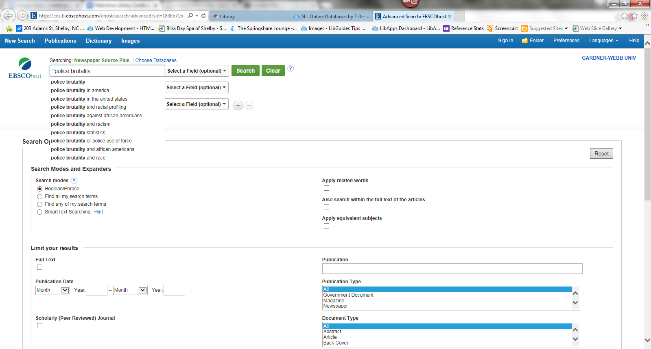
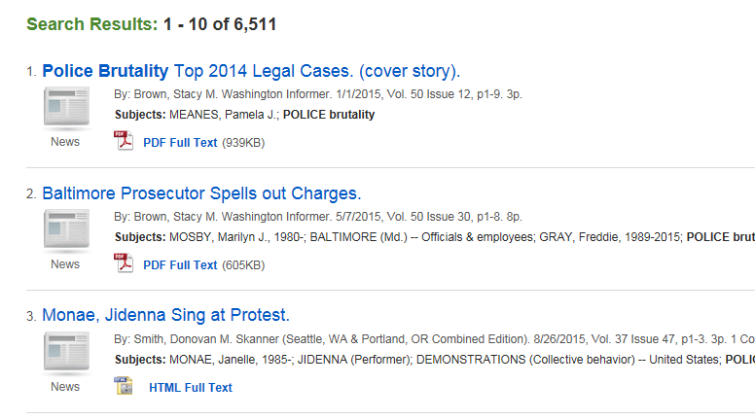
Newspaper Source Plus

Slide 18
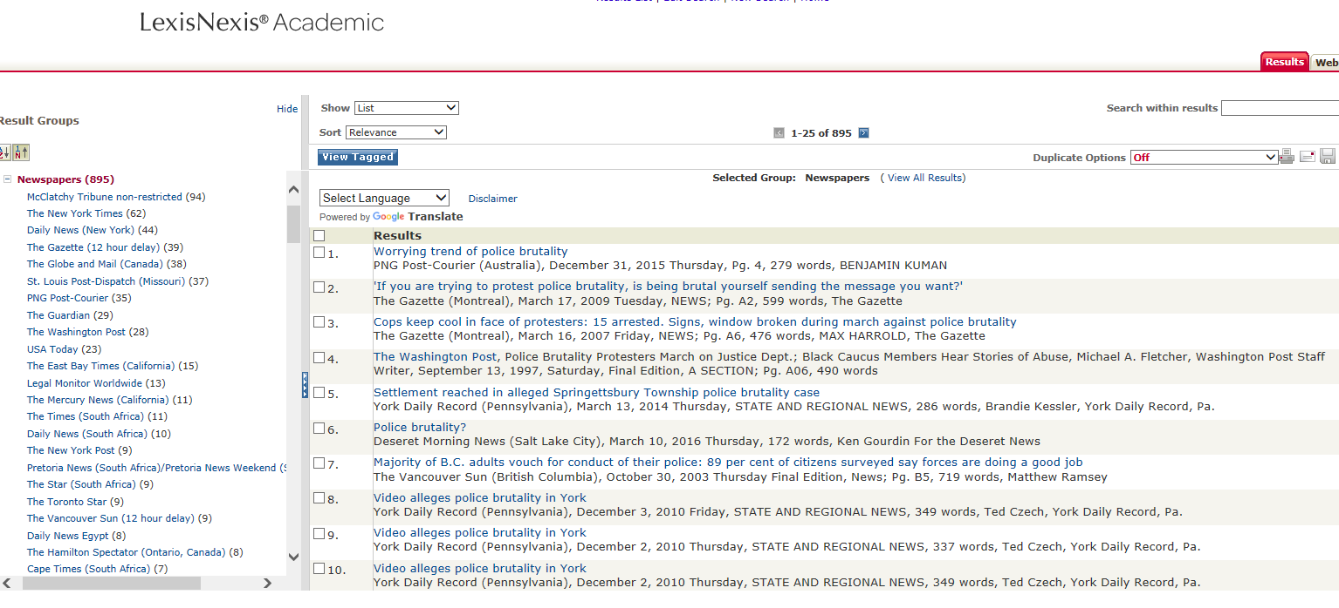

Slide 19
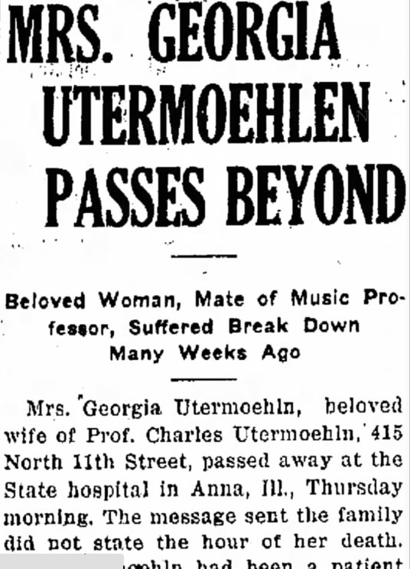
The Daily Independent (Murphysboro, IL) - 13 February 1925
The Daily Independent (Murphysboro, IL) -
20 September 1923

Slide 20
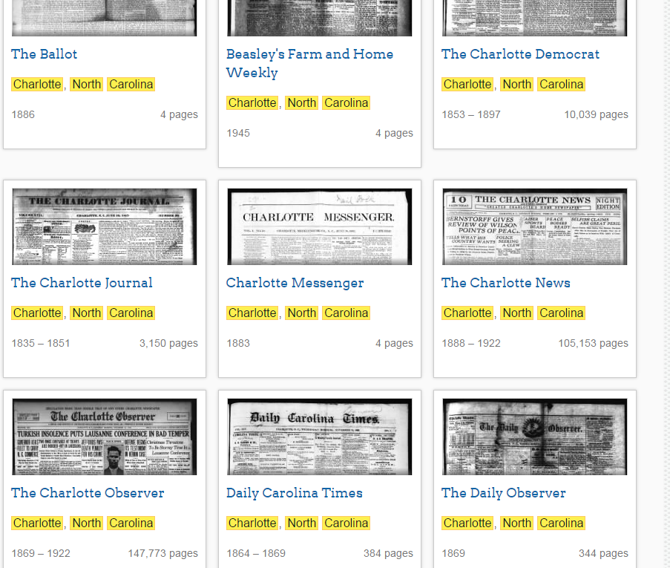
Newspapers.com

Slide 21
Google Books

Slide 22
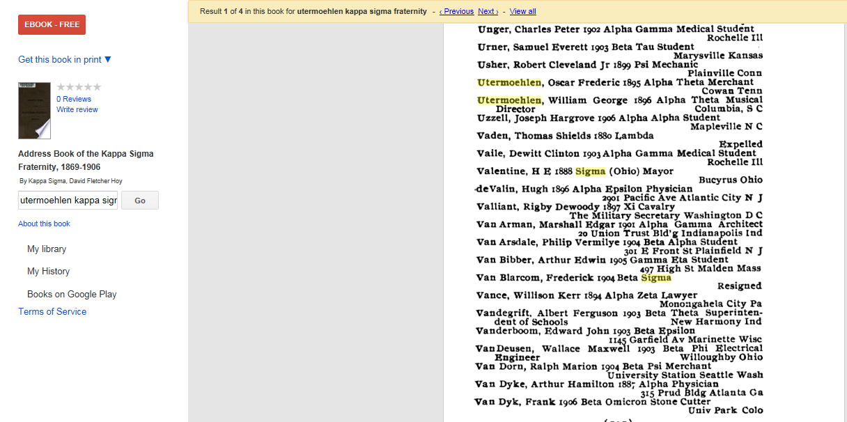
Kappa Sigma., & Hoy, D. F. (1906). Address book of the Kappa Sigma fraternity, 1869-1906.
Ithaca, NY: Andrus & Church.

Slide 23
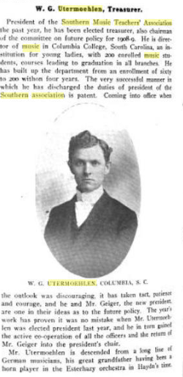
Musical courier: A weekly journal devoted to music and the music trades. (1908). New York: Musical Courier Co.

Slide 24
Google Scholar

Slide 25
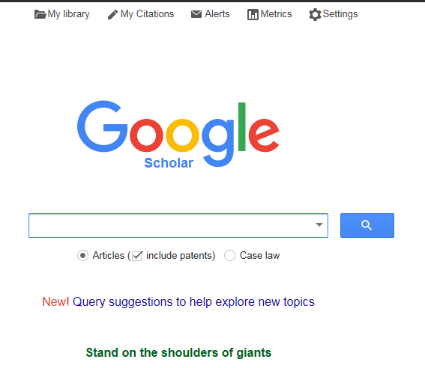
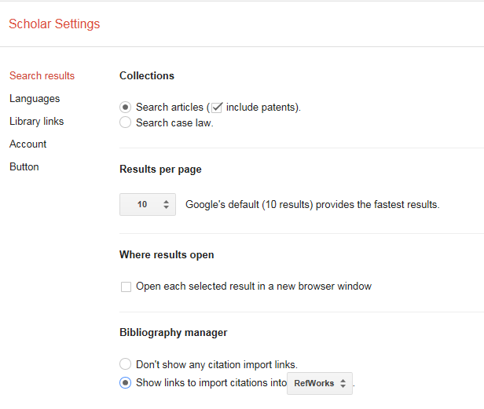

Slide 26
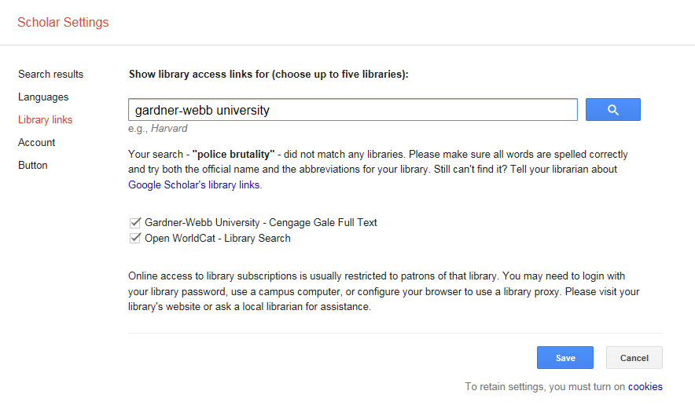

Slide 27
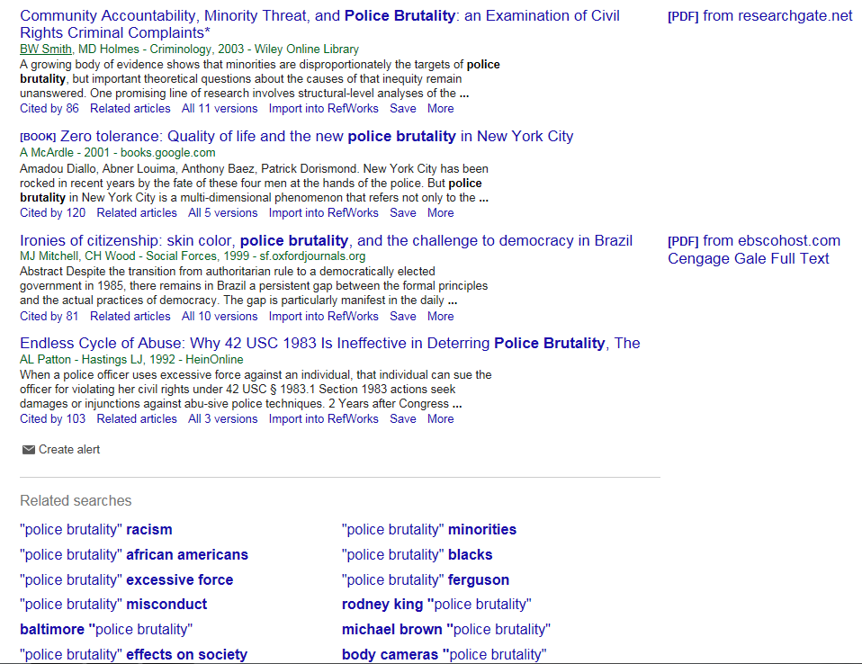

Slide 28
Questions and Sharing

Slide 29
Contact information
Dr. Pam Dennis
Reference and Instruction Librarian
pdennis@gardner-webb.edu
704-406-3051

