Slide 1
Burnout and Libraries
Presentation for
Metrolina Library Association
Presenter:
Martin House
June 9, 2015

Slide 2
Going Through the Motions?
Do you ever feel like you’re just going through the motions at work?
Do you ever feel just emotionally drained by work?
Are you physically present, but not mentally?

Slide 3
What You Feel
Emotional Exhaustion

Slide 4
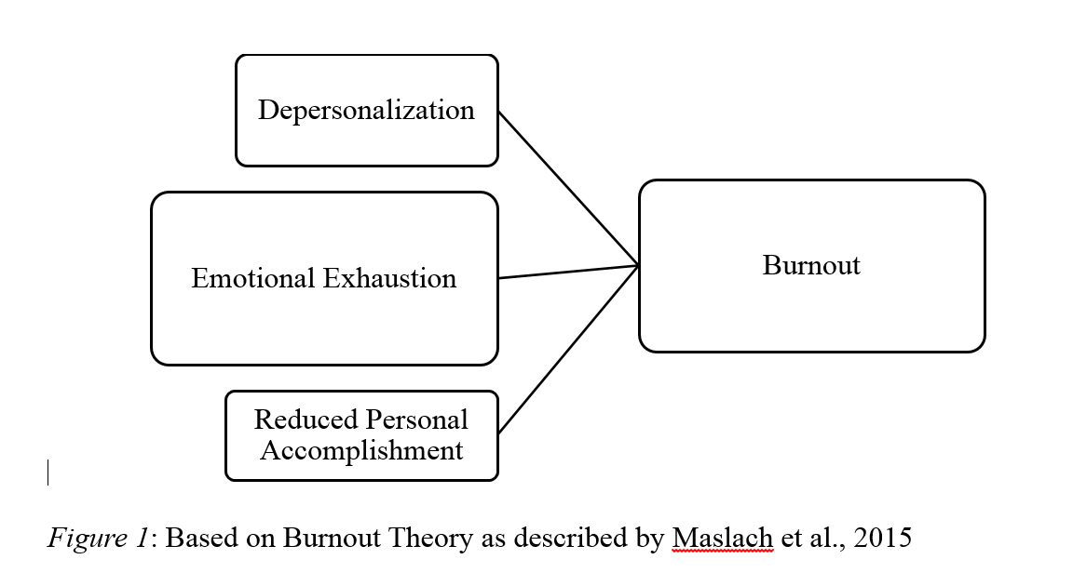
A Little bit of Academia
Research says!

Slide 5
Low Functioning and Chronic Stress

Slide 6
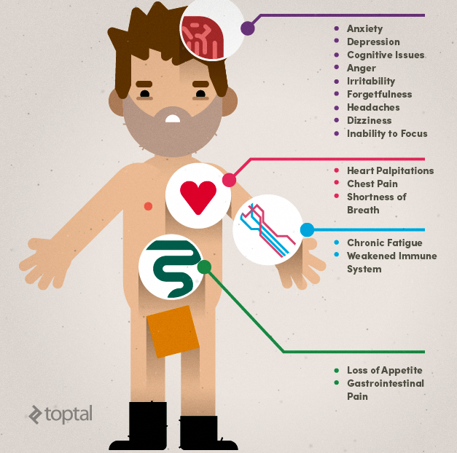
Walk Through the Fire
Emotional & Physical Health Issues

Slide 7
Some (brief) Statistics

Slide 8
Organizational “Costs”
Grumpy
Library Staff
Unhappy
Patrons
=

Slide 9
Buffy says…
Burnout bad / Happy Library = good

Slide 10
I’ve Got a Theory!
(Well… at least a hypothesis)
Situation/
Person
Temporary
S.
G.
T.
P.
How?
Why?
When?
General
Permanent

Slide 11
Human Service Survey
Think about your survey results.

Slide 12
Give Me Something to Sing About!
The Unexamined Life,
is not Worth Living

Slide 13
A few “not so” Fun Facts
The single biggest
source of burnout
is the supervisor-employee
relationship
High Job Demand
& Low Resources
= High Burnout
Emotional Exhaustion
= Greatest Predictor
of Burnout
Burnout =
Low job & life satisfaction
Chronic health issues
Increased mortality rates

Slide 14
Discussion:
If you are experiencing burnout on any level right now:
What is your take away?
What will you do as an employee?
If you are a supervisor, do you recognize some of these symptoms?
As supervisors, what do you think you should do?
Let’s talk strategies for coping

Slide 15
Strategies
Find Your Escapes
Reflect
How?
Why?
When?
Disconnect a Little
Take a Walk

Slide 16
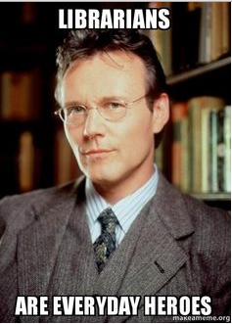
Gratuitous Slide

